Slide 1
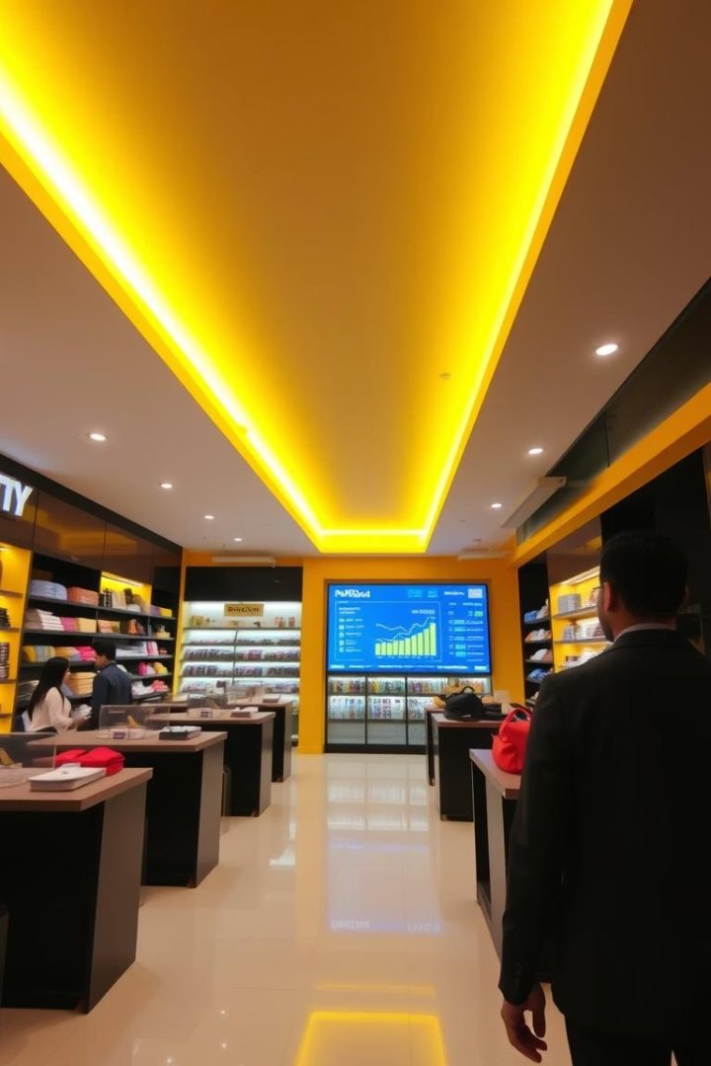
Retail Sales Performance Analysis: HIRA Store
This presentation explores annual sales data from Hira Store. We uncover business insights to improve decision-making and operational performance. Analysis covers sales channels, customer demographics, and regional trends.
Rahul Prasad
22BCA10128

Slide 2
Project Overview & Objectives
Purpose
Scope
Analyse Hira Store's sales data for actionable insights. Focus on sales channels, customer behaviour, and regional performance.
Data from Amazon, Myntra, Flipkart, and others. Metrics include order volume, revenue, demographics, and geography.

Slide 3
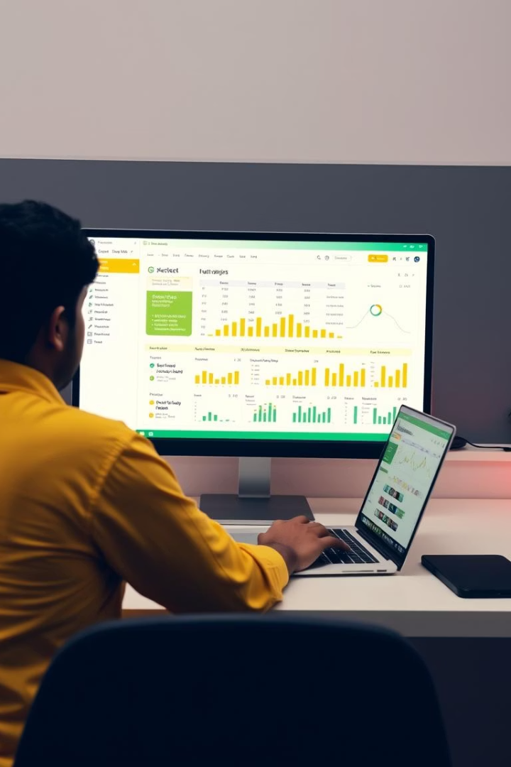
Data Analysis Techniques
Data Cleaning
Exploratory Analysis
Removed duplicates, handled missing entries, and standardised formats.
Used charts to visualise trends by month, gender, and region.
Segmentation
Analysed sales by gender, age, state, and channel.

Slide 4





Key Metrics & Formulas
Total Sales
Average Order Value
Status Distribution
Sum of all order amounts.
Total sales divided by number of orders.
Percentage of delivered, cancelled, and refunded orders.
Monthly Sales
Sales grouped by month.

Slide 5



Sales Channel & State Performance
High-Performing States
Haryana, Karnataka, and Tamil Nadu showed highest sales.
Top Channels
Growth Opportunities
Amazon, Myntra, and Flipkart led in sales volume.
Punjab, Delhi, and Maharashtra are key for targeted marketing.
2
1
3

Slide 6

Customer Demographics & Product Trends
1
Gender
Female customers made up 64% of sales.
2
Age Groups
Women aged 40–49 were the most active buyers.
3
Product Categories
Kurta was the best-selling category, followed by Sets and Western Dress.

Slide 7




Order Status & Operational Insights
Delivered Orders
92% of orders delivered, showing high efficiency.
Returns & Cancellations
Minimal returns and cancellations, indicating customer satisfaction.
Order Sizes
M, L, and XXL were most frequently ordered sizes.

Slide 8
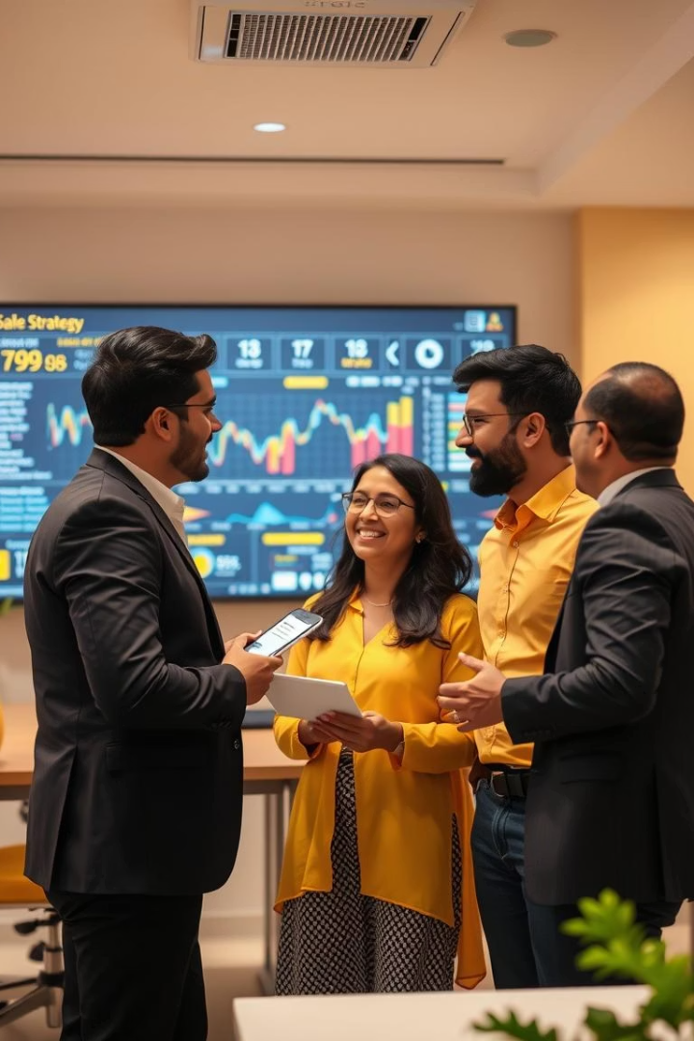
Summary & Recommendations
Targeted Marketing
Inventory Optimisation
Focus on high-performing regions and customer segments.
Stock best-selling categories and popular sizes.
Future Initiatives
Explore AI-driven insights, customer segmentation, and dynamic pricing.

